Slide 1

AN INTRODUCTION

Slide 2













MTW: A COALITION OF UK EMPLOYERS AND CIVIL SOCIETY
Founded in 2013

Slide 3

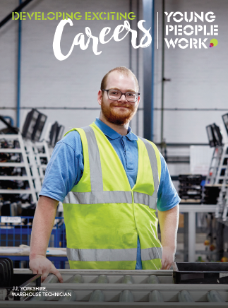
MTW: OUR VALUES
Our Purpose
…we exist to empower young people, who most need our support, to fulfil their potential through work.
Our Vision
…to level the playing field for all young people by removing barriers to employment through quality work placements and vocational training.
Our Ambition
…100,000 placements completed by 2020
…50,000 positive outcomes by 2020

Slide 4

MTW: OUR IMPACT
Over 95,000 workplace placements completed to date
56% positive outcomes achieved

Slide 5
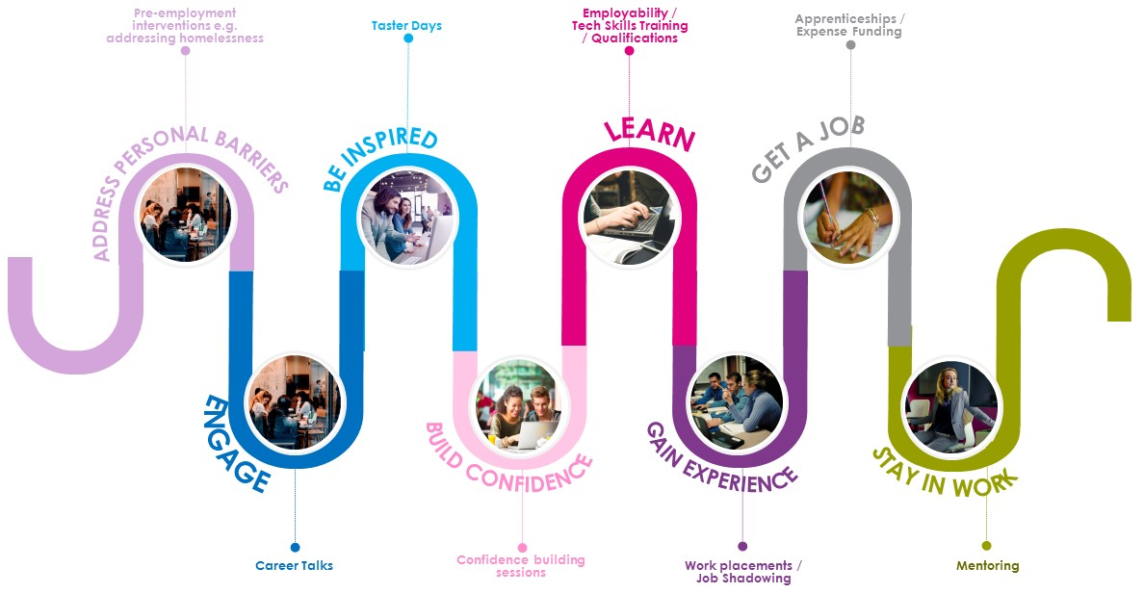
MTW: WHERE WE OPERATE ON THE EMPLOYMENT JOURNEY
Focus
of MtW

Slide 6
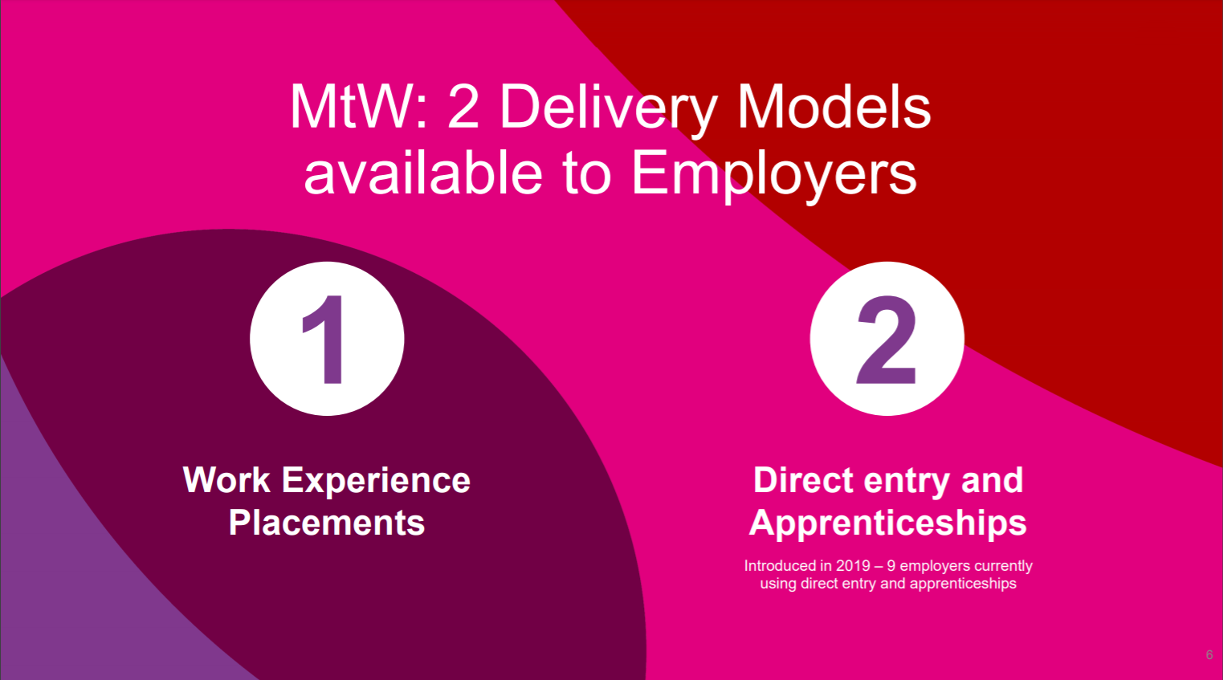

Slide 7
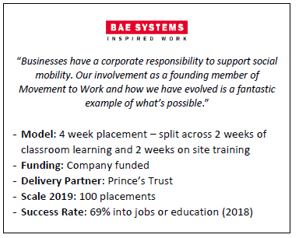
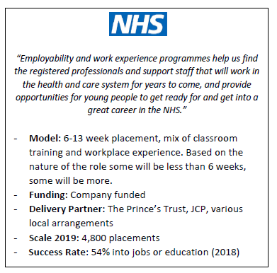
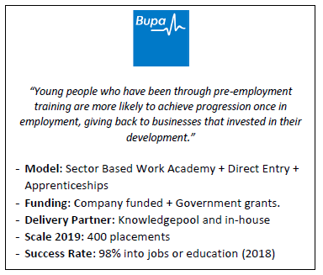
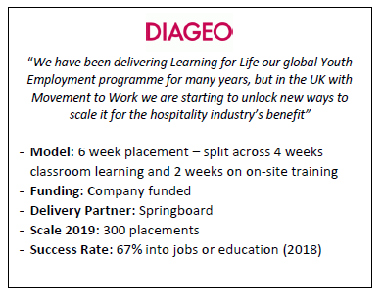
MTW: EMPLOYER MODELS
PROGRAMME EXAMPLES

Slide 8

MTW: PROJECT 16-18
SCHOOL ENGAGEMENT
Set up in 2019; several employers have joined Movement to Work under this remit
Identify 16-18yr olds who are less likely to attend activities that meet Gatsby Benchmark 6 (experiences of workplaces) whilst in education, and are therefore more at risk of becoming NEET
Work with employers to identify opportunities to engage these groups in activities that meet GB6 whilst still in education e.g. work placements

Slide 9


























MTW: THE PARTNER NETWORK
ACROSS GEOPGRAPHY, FOCUS COHORTS AND PROGRAMME DESIGN
OVER 50 ORGANISATIONS TO SUPPORT DELIVERY
Notes:
This slide shows those who have completed the process to become members of the MtW Partner Network
To the left are the commercial training providers
As we go across to the middle, this area includes the charitable training providers
The right hand side shows those who work in youth outreach and will build confidence and provide support prior to a person commencing an employability course.
An employability course will teach a skill such as customer service combined with Maths and English plus other specialist areas such as conflict management. The variety of courses which can be provided are vast.

Slide 10




MTW: THE PARTNER NETWORK
THE BENEFITS
Finding the right partners
Getting Started
Optimising delivery
Maximising impact
Finding the right partners in our approved network to deliver an employability programme – providing consultation and a bespoke solution based on employers’ business need.
Supporting existing employer members and sharing expertise to optimise programme delivery.
Specialist advice and resource to aid programme delivery – supporting you through your first placement and helping with the potential pitfalls.
Creating opportunities for those who are hardest to reach through our outreach network, facilitating a greater impact on diversity in recruitment

Slide 11
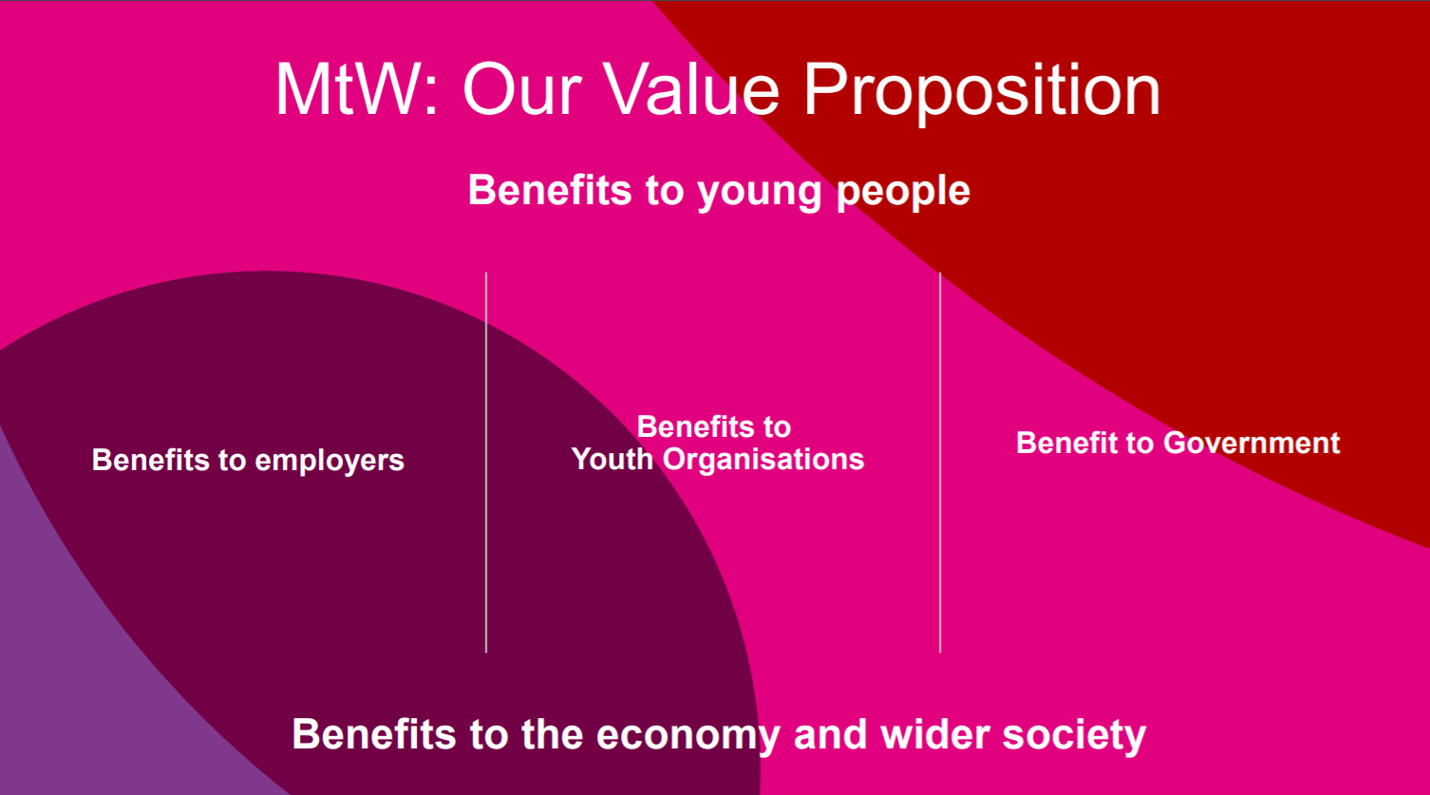

Slide 12
MTW: BENEFITS TO EMPLOYERS
FROM SME’s TO CORPORATES
Return on Investment
Diversity and Inclusion
Positive Social Impact
Additional funding can be utilised to minimise cost to employers, reducing recruitment costs vs traditional channels.
The NHS found additional benefits including:
9% reduction in staff turnover
2% reduction in staff absence
overall 250% return over a 5yr period.
Across MtW members, we have collectively delivered placements comprised of:
52% females
18% BAME and
18% those who identify as having a disability.
This is directly representative of the NEET population generally, meaning we make a real impact on those most in need.
MtW's network includes civil and charitable entities supporting a specific group such as ex-offenders, care leavers, those with a disability and refugees.
Choosing to work with these groups and others helps stimulate social mobility and support Corporate Social Responsibility efforts, including commitments to UN Sustainable Development Goals.

Slide 13
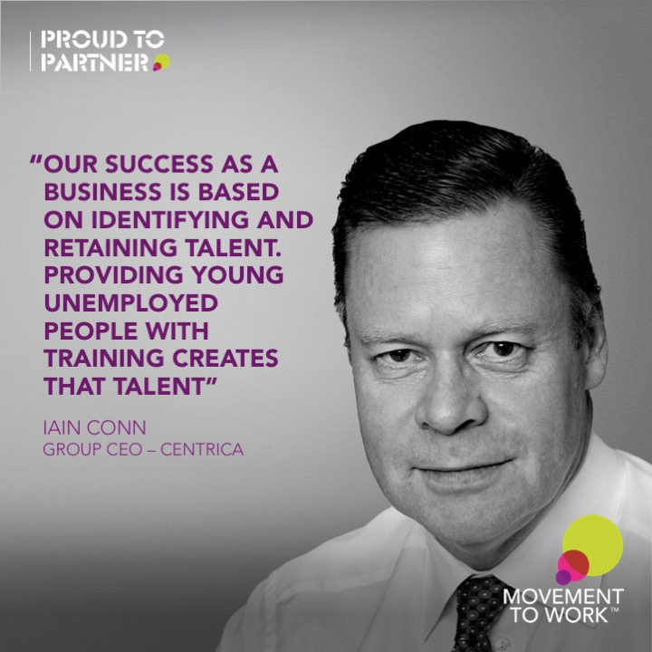

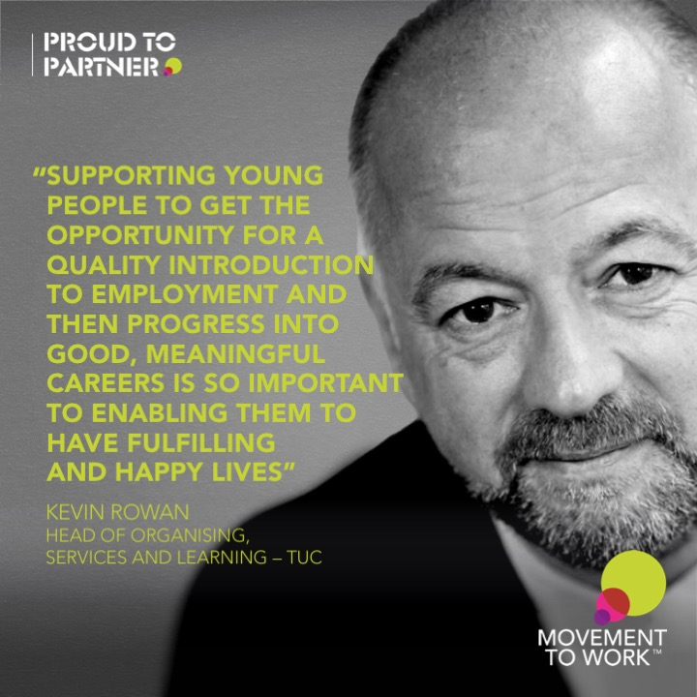
MTW: EMPLOYER PERSPECTIVES
WE ALL HAVE A ROLE TO PLAY

Slide 14
TALK TO US ABOUT HOW YOU COULD GET INVOLVED!
Sophia Spencer
Head of Partnership Development
M: +44 (0)7827 820658
E: sophia.spencer@baesystems.com
Debbie Gordon
Head of Outreach
E: debs.Gordon@movementtowork.com
W: www.movementtowork.com

